Slide 1
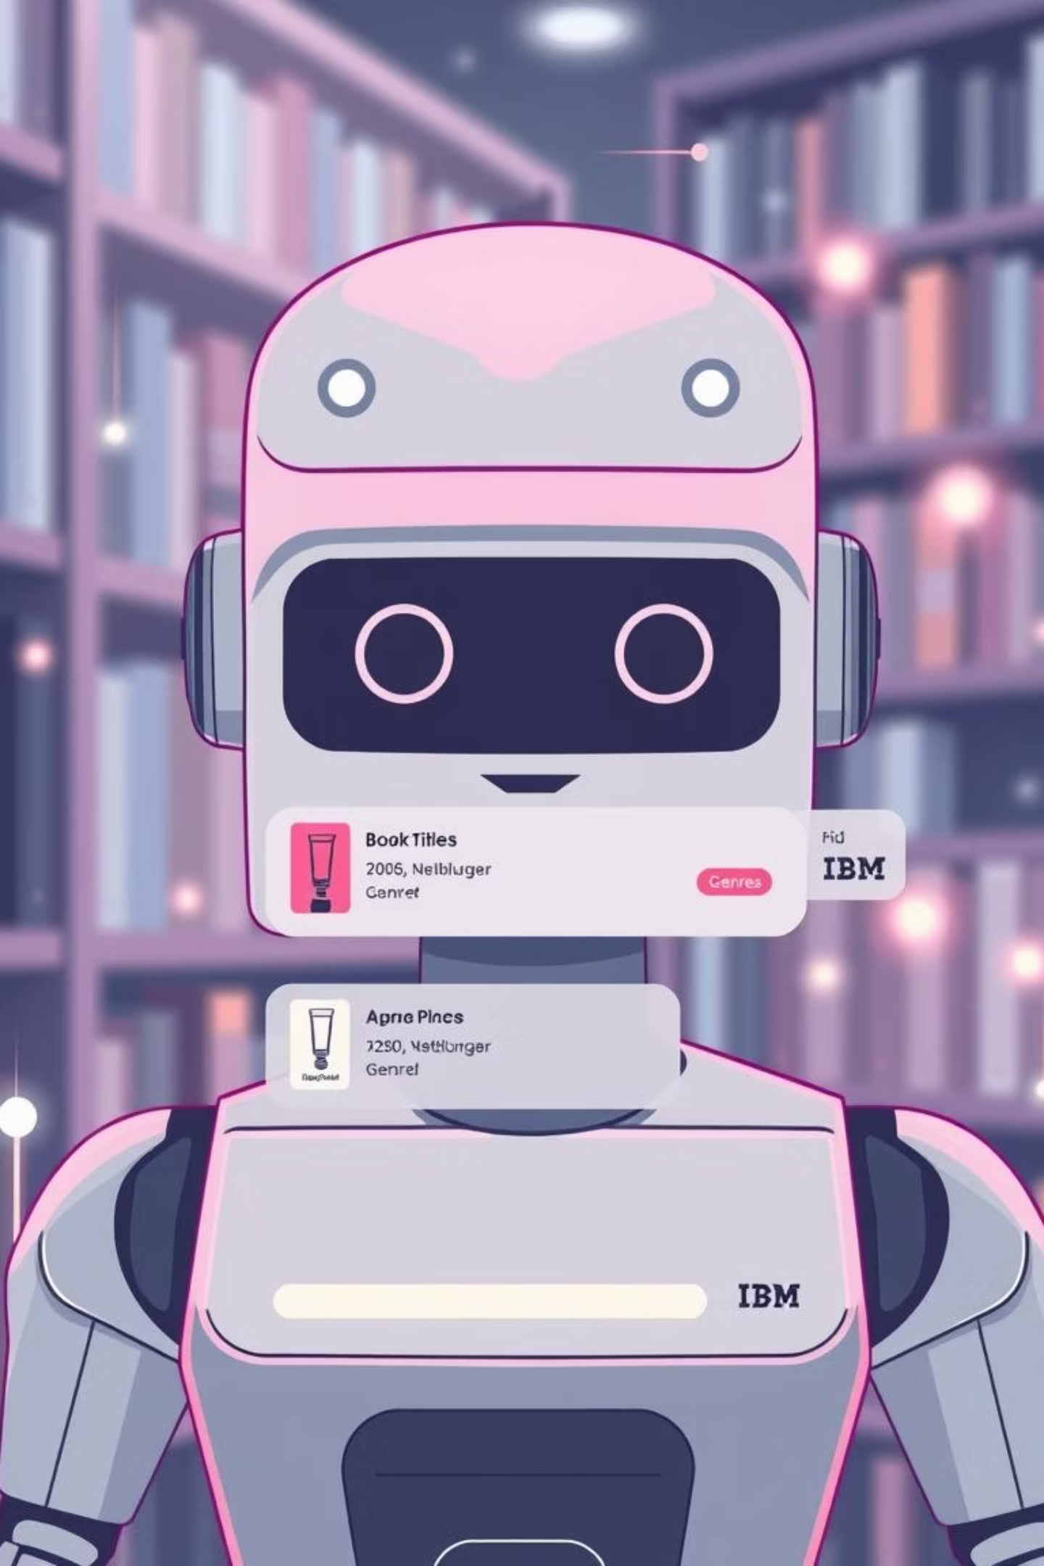
IBM Book Recommendation Chatbot
A genre-based book recommender built with IBM Watson Assistant.

Slide 2
Project Overview & Team
Project Title
Submitted By
Book Recommendation Chatbot using IBM Watson Assistant
Name: Syed Mohd Altamash
College: United College of Engineering And Research
Objective
Roll No: 2300100100439
To develop an intelligent chatbot that suggests books based on user-specified genres (e.g., fantasy, mystery, sci-fi), enhancing book discovery through natural language conversation.
Submitted To
Mr. R Devnath (Faculty/Guide)

Slide 3
Declaration & Acknowledgement
Declaration
Acknowledgement
I hereby declare that this virtual internship project on the Book Recommendation Chatbot using IBM Watson Assistant is my original work. All efforts have been made to ensure the accuracy and authenticity of the content presented.
I extend my sincere gratitude to Mr. R Devnath for his invaluable guidance and support throughout this project. I also thank the IBM PBEL team for providing this enriching virtual internship opportunity and my college, United College of Engineering And Research, for their continuous encouragement and resources.
This project would not have been possible without the collective support and insights from my mentors and institution.

Slide 4
Table of Contents
1
Introduction to Chatbots
Understanding the role of conversational AI in modern applications.
2
Technologies Involved
Deep dive into IBM Watson Assistant and its core components.
3
Problem Solving & Implementation
Addressing challenges and detailing the solution architecture.
4
Key Features & Dialog Flow
Exploring the chatbot's capabilities and conversation logic.
5
Website Integration
Seamless deployment strategies for web applications.
6
Project Output & Conclusion
Demonstrating the chatbot in action and summarizing key learnings.

Slide 5



Technologies Involved
Our book recommendation chatbot leverages the robust capabilities of IBM Watson Assistant, a powerful AI-powered conversational platform.
IBM Watson Assistant
Natural Language Understanding (NLU)
Dialog Management
A comprehensive conversational AI service that enables developers to build, deploy, and manage AI assistants across various channels.
The platform provides tools for designing complex conversational flows, managing context, and handling diverse user interactions.
Watson's NLU capabilities allow the chatbot to understand user intent and extract key information (entities) from conversational input.

Slide 6
Key Features
1
2
Genre-Based Recommendations
Intent Recognition
Utilizes the @genre entity to identify user preferences and suggest books tailored to specific categories like fantasy, mystery, or sci-fi.
Recognizes core user intents such as greet (for welcoming users), recommend_book (for book requests), and thanks (for acknowledging appreciation).
3
4
Robust Fallback Handling
Easy Web Integration
Designed to gracefully manage unrecognized inputs, ensuring a smooth user experience even when queries are ambiguous or outside predefined scope.
Seamlessly integrates into any website using a simple script tag, requiring no complex backend code for deployment.

Slide 7





Dialog Flow: How It Works
The chatbot's conversational logic is structured to guide users efficiently to their desired book recommendations.
Provide Suggestions
Handle Fallback
User Greets
Detect Genre
This simplified flow ensures a focused and effective interaction, leading users to relevant book suggestions.

Slide 8

Website Integration
Seamless Deployment
The chatbot is integrated using the Watson Assistant Web Chat, a lightweight client-side solution.
Implementation
A simple script tag is added to the website's HTML.
The chatbot appears as a discreet bubble in the bottom-right corner.
No server-side code or complex API calls are required on the website's backend, making deployment straightforward and quick.

Slide 9
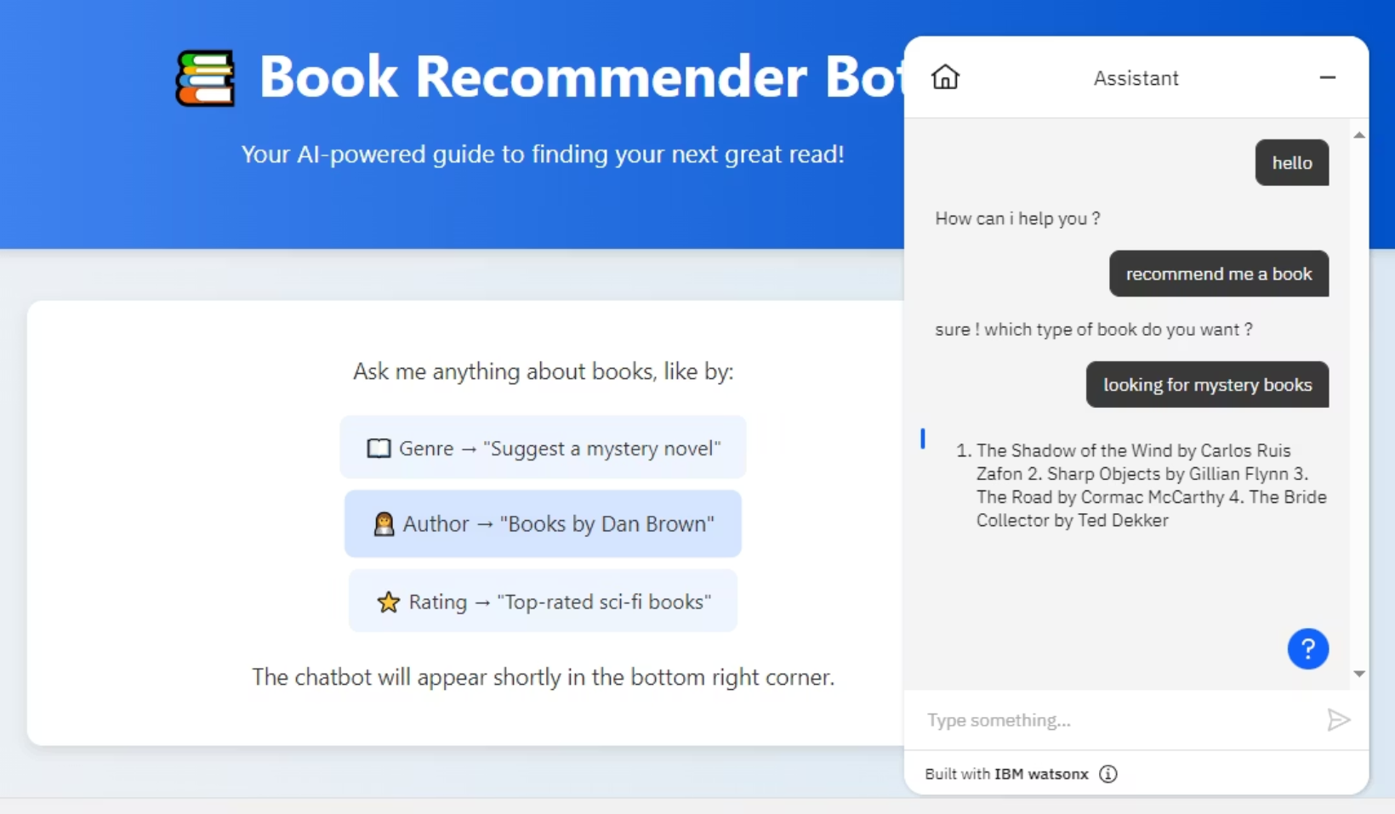
Project Output & Conclusion
Summary of Achievements
Successfully developed a simple, yet effective chatbot.
Primarily focused on genre-based book recommendations.
Built efficiently using IBM Watson Assistant.
Demonstrated easy deployment capabilities.
Future Scope
Potential for expansion to include author-based recommendations, book summaries, and personalized user profiles.

